Slide 1
Autoimmunity
Tolerance: A state of Unresponsiveness to
self Ag
Tolerogen: any substance that cause tolerance
Autoimmunity: Breaking of self-tolerance
Involve
-Autoantibodies that activate complement system and ADCC mechanism
-CMI that activate CD4+ and CD8+ cells

Slide 2
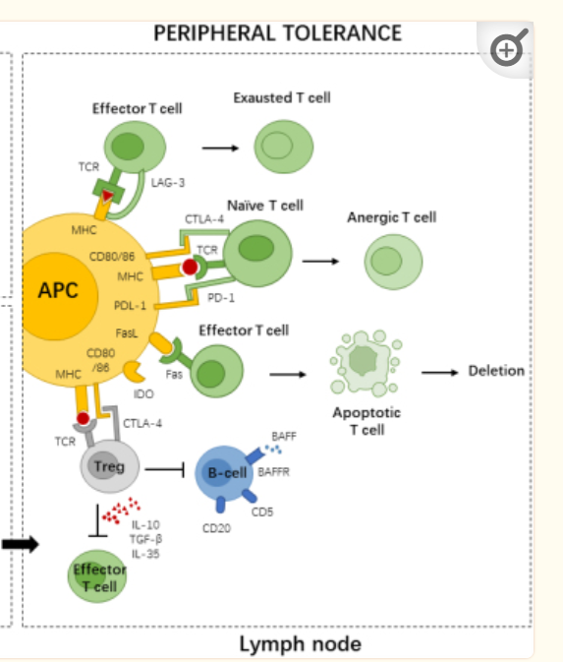
Positive and negative selection in the thymus

Slide 3
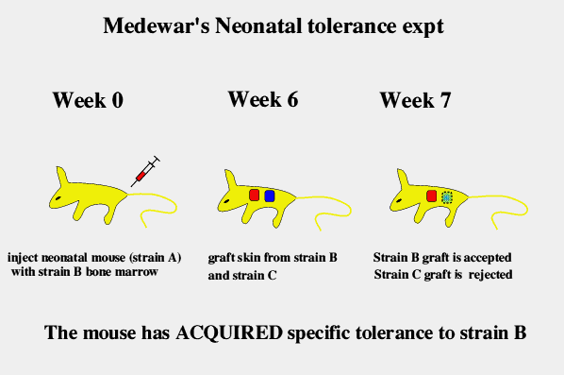
Demonstration of Tolerance
B
A

Slide 4
Oral Tolerance
The GIT is the largest immunologic organ in the body. It is constantly bombarded by dietary proteins.
Despite the extent of protein exposure, very few patients have food allergies because of development of oral tolerance to these Ags.
Different cells of the immune system participate in oral tolerance induction, with regulatory T cells being the most important.

Slide 5
Immune privilege Sites
Do not develop i.r. to pathogens or tumors
include eye, testes, ovary, brain and placenta
Corneal transplant:
No need for tissue matching and immunosuppressive therapy. Why?
a. lack of lymphatic drainage
b. brain barrier
c. release of cytokines IL-10 and TGF
d. Expression of FasL:
human corneal endothelial cells and retinal epithelial cells have FasL
Mouse:allogenic transplant--→No rejection
gld/gld mice (lack FasL)----→Allograft rejection

Slide 6
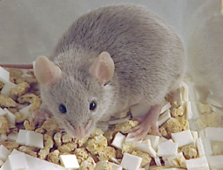
Allogenic cornea transplant
Wild
gld/gld
FasL negative
FasL positive
↓
↓
No rejection
rejection

Slide 7
Causes of Autoimmunity
Genetic factors:
Polygenic: No individual gene is sufficient to elicit the disease.
Heterogenous
Genetic predisposition: Associated with HLA: MS w DR2, MG w DR3, RA w DR4

Slide 8
Environmental factors
a. Release of sequestered Ags due to an accident or infection
chondrocytes Ag of cartilage
Cardiac Ags as myocarditis,
b. Molecular mimicry
Abs or T cells specific to microbial Ags cross-react with self Ag. (Epitope homology)
e.g. Rheumatic fever follow S. pyogenes infection with protein M that have AutoAbs to cardiac myosin Ag.
IDDM GAD w Coxsackievirus

Slide 9
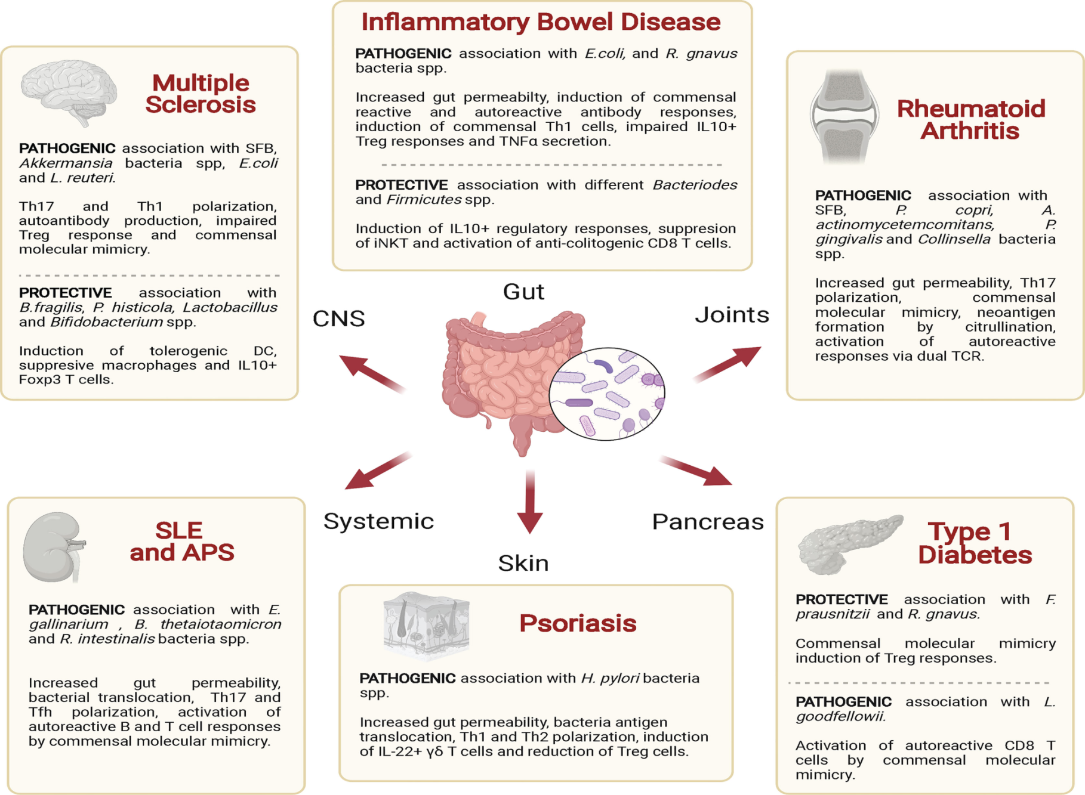
XXX

Slide 10
c. Polyclonal : Nonspecific trigger many B and T cell clones including autoreactive cells.
e.g. SuperAg, LPS (Gm -), bac lipoteichoic acid (Gm +), hypomethylated CpG Bac DNA
d. Drugs and Hormones
SLE is more common in females due to estrogenes
Penicillin bind protein on RBC
α-methyl Dopa (antihypertensive drug)
Self limiting

Slide 11
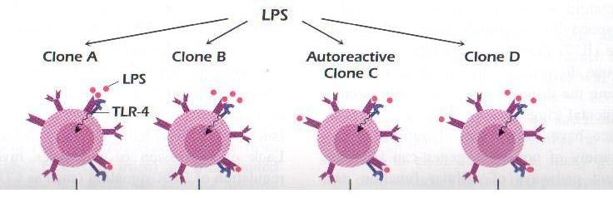
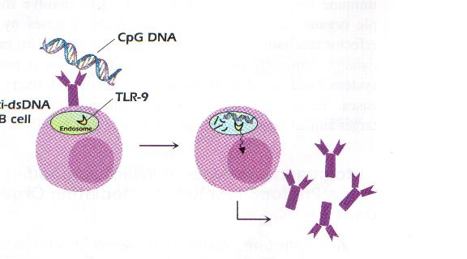

Slide 12
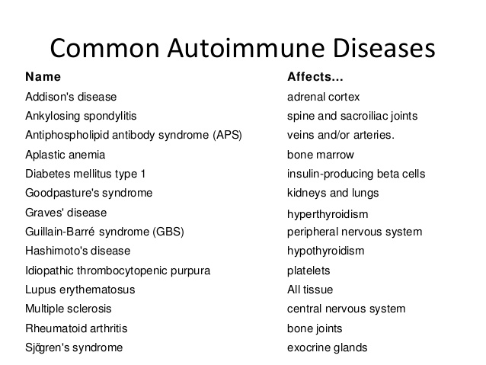
XXX

Slide 13
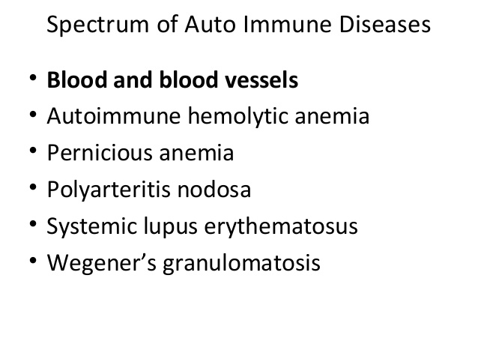
XXX

Slide 14
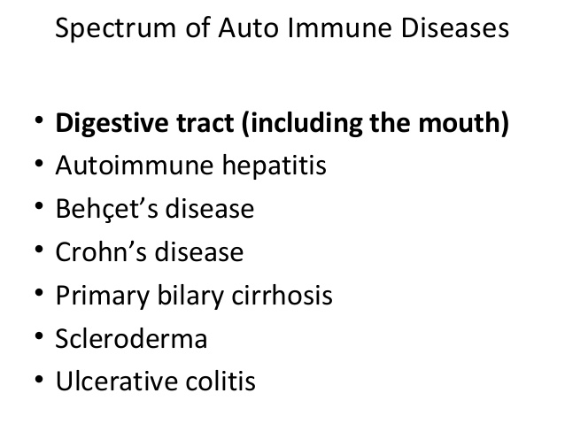
XXX

Slide 15
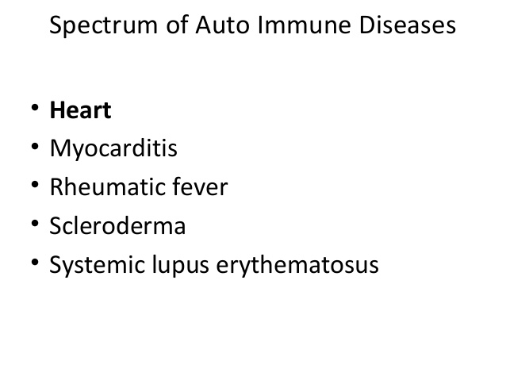
XXX

Slide 16
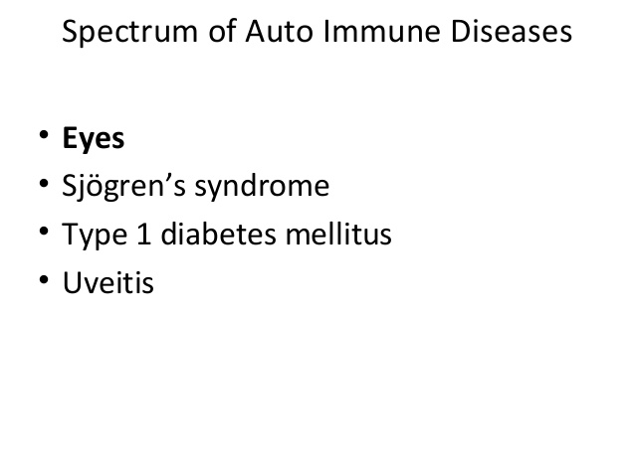
XXX

Slide 17
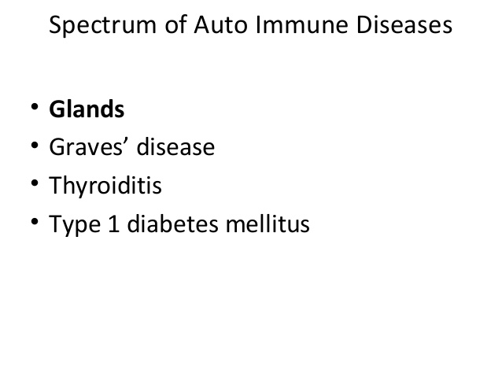
XXX

Slide 18
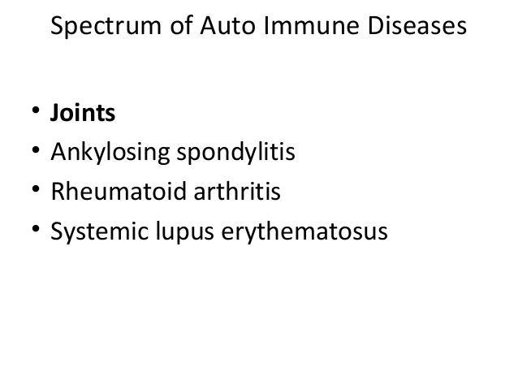
XXX

Slide 19
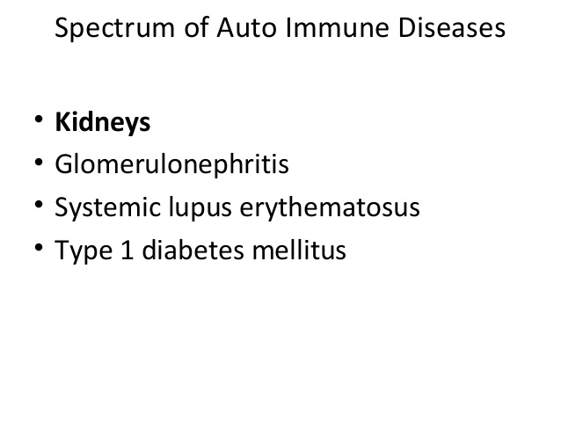
XXX

Slide 20
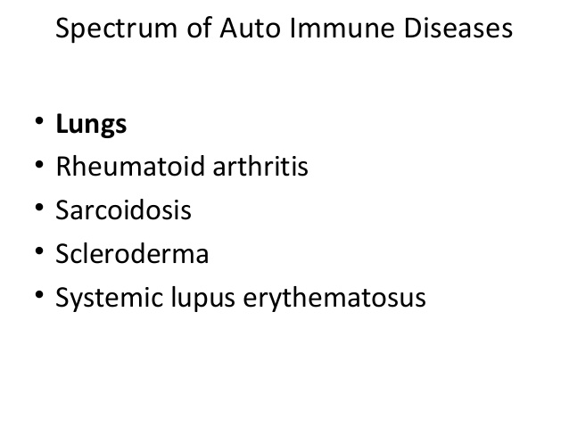
XXX

Slide 21
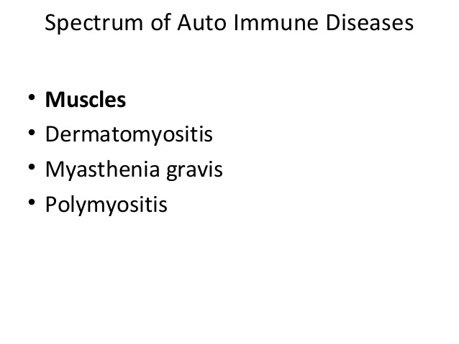
XXX

Slide 22
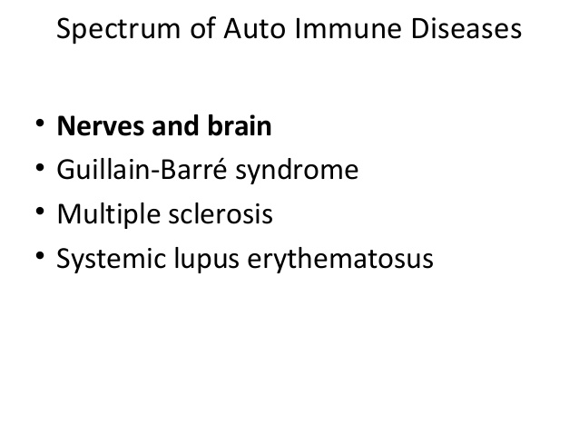
XXX

Slide 23
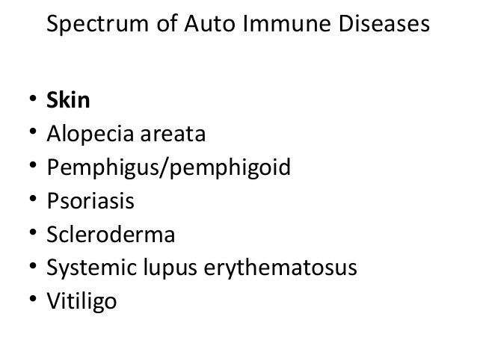
XXX

Slide 24
Abs Predominate Autoimmune Diseases
Autoimmune Hemolytic anemia
AutoAbs to surface Ags on RBCs
a. WarmAutoAbs react optimally at > 37ºC, IgG, Rh Ag
RBCs are coated usually with IgG alone or together with complement, and are therefore taken up by macrophages which have receptors for the Ig Fc fragment binds to RBCs at 37˚c.
Ab bounded RBCs trapped in the spleen. The spleen is often enlarged (splenomegaly).

Slide 25
b. Cold AutoAbs react optimally at <37ºC, IgM, AgI, associated with Mycoplasma pneumonia. Patients exposed to cold temp. show symptoms in extremities
In this disease the patient has a chronic haemolytic anaemia aggravated by the cold. Mild jaundice and splenomegaly may be present.
After binding with RBCs the IgM activate complement system(C3b) which will lead to RBC damage .
Treatment consists of keeping the patient warm and the same treatment as warm Hemolytic anemia.

Slide 26
Myasthenia gravis MG
Abs against Acetylcholine R
Act as antagonist that blocks binding the R
Symptoms: Muscle weakness, inhibition of nerve impulse, problem in chewing and swallow and respiration
Linked w thymoma (hypertrophy of thymus): removal of thymus lead to regression of the diseases. (cross-reaction thymus and Ag R).
Thymomas in MG are neoplasms (cancer) derived from thymic epithelial cells.
Researchers believe the thymus gland triggers or maintains the production of the Abs that block acetylcholine causing MG.
In thymoma MG, epitopes are shared between the thymoma and muscle proteins.
Animal model: injection mouse with AChR--→induce MG ( AChR from Torpedo fish)

Slide 27
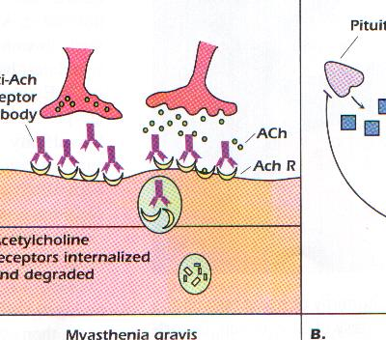

Slide 28
Graves Disease
Abs against TSH R
Agonist: hyperactive thyroid (Hyperthyroidism)
Nervousness, Wt loss, increase in metabolism, bulging eyes
Pregnant mother give to the fetus through Abs

Slide 29
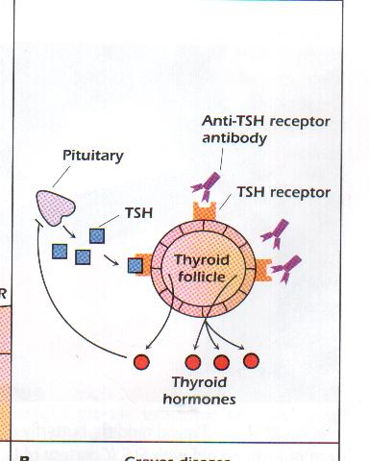
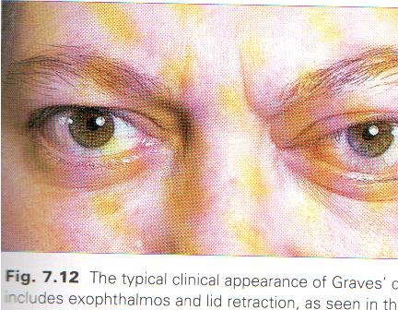

Slide 30
Systemic Lupus Erythematosus SLE
Abs to dsDNA, ssDNA, histones, ribonuleoprotein, RBC and neurons and others
Abs against dsDNA better correlates w the disease.
Abs to ssDNA produced in normal individual
Attack many organs so IC that trapped in glomerulus (damage skin, joints, kidney, heart), hematouria, proteinuria. Most patients die from kidney damage
Associated w EBV
Animal model: NZB/NZW
No cure. Symptoms treated with anti-inflammatory and immunosuppressive drugs.

Slide 31
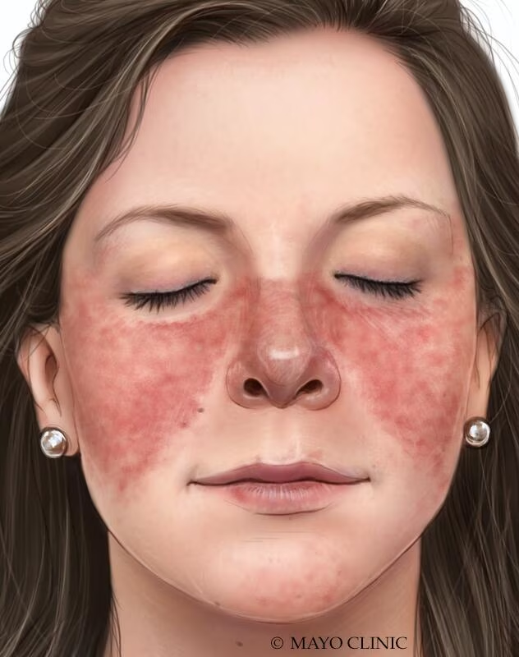

Slide 32
T cells predominate
Hashimoto's thyroditis
Destruction of thyroid cells-Hypothyroidism---------goiter
AutoAbs to thyroglobulin. Thyroglobulin is a protein made by the thyroid gland. The thyroid uses it to make the hormones triiodothyronine (T3) and thyroxine (T4).
Cold intolerance, weight gain

Slide 33
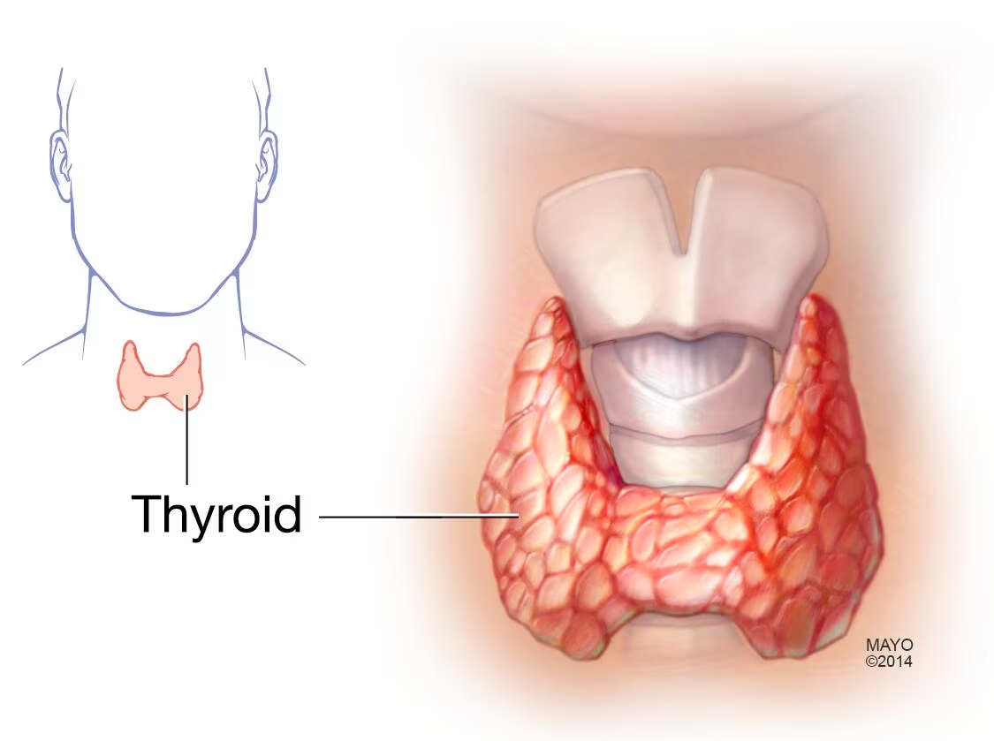

Slide 34
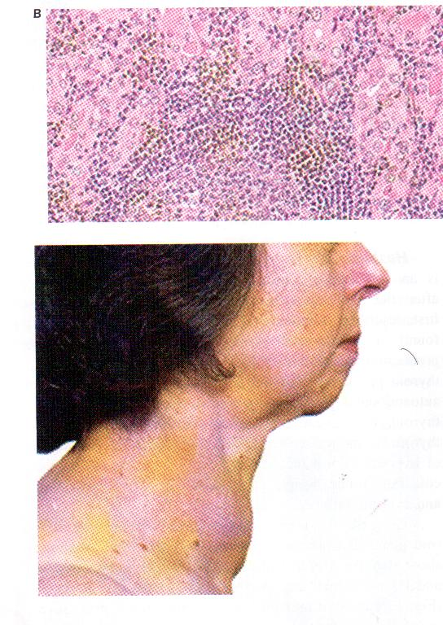

Slide 35
Multiple sclerosis
Auto T cells destruct the myelin sheath- Loss of coordination
Animal model: EAE
Injection with MBP with CFA cause MS (EAE)
Association with DR2
Oral tolerance: ingestion of MBP prior to injection relieve the symptoms in animals It does not work in humans
Treatment: There is no cure for MS, but there are treatments that can reduce the number and severity of relapses and delay the long-term disability progression of the disease
The most prescribed medications is SC Injectable Interferon beta and IV Corticosteroids
In August 2023 the FDA approved natalizumab, for the long-term treatment of MS. binds to α4β1-integrin and blocks its interaction with VCAM-1 (adhesion molecule) prevent ent WBCs migration.

Slide 36
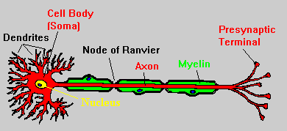
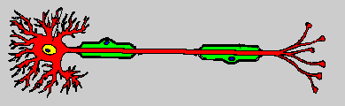

Slide 37
Type I IDDM
Destruction of β cells of Pancreas (Ag: glu decarboxylase or GAD) and insulin by T cells.so Characterized by insufficient insulin production
Activation of CD4+ (secretion of IL-1, 6, TNF-alpha) and CD8+
Linked to coxsackievirus
Animal model: NOD mice
Diabetes is not contagious ("catching").
There are no known ways to prevent type 1 diabetes in children.
Treated with insulin injections.

Slide 38
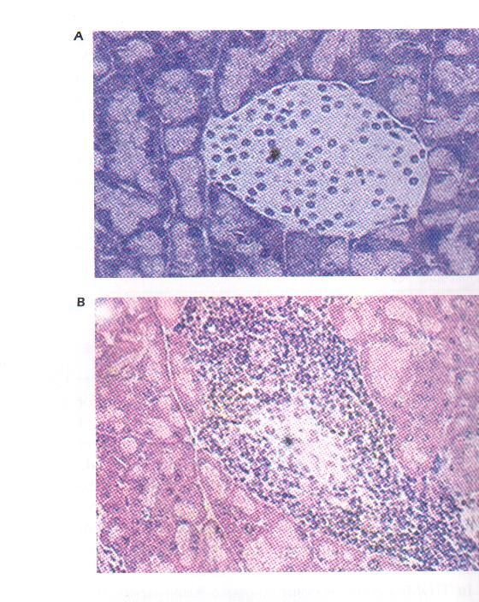

Slide 39
Rheumatoid arthritis
Chronic inflammation of the joint (inflammation of the synovium, dense T, B, NK, mac)-destruction of cartilage and bone-replaced by fibrous tissue.
RF: Abs (IgM and IgA) against self IgG: minor role
CD4+ Th1: has dominant role
CD4+ Th17 with the inflammatory cytokines: bone and cartilage destruction
Associated w DR4
Linked to EBV, rubella and flu
Mouse model →injection w collagen II→ RA model
Treatment: No cure. Symptoms treated with anti-inflammatory (aspirin) and immunosuppressive drugs.
Methotrexate is now considered the first-line agent for most patients with RA
New FDA approved 2023: IL-6 R antagonist

Slide 40
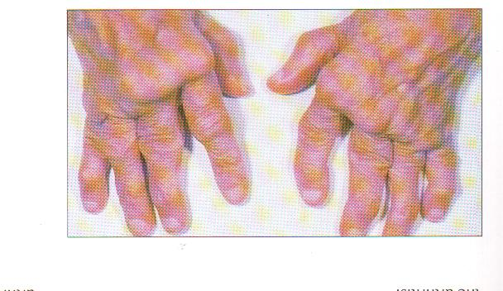

Slide 41
Therapeutic strategies
1. cytotoxic drugs like cyclophosphamide or azathioprine that interfere w DNA replication
2. Blockage of intracellular signals like Cyclosporin A and FK506
3. Anticytokine therapy Anti-TNF-α and Anti-IL-1β Mabs

